Slide 1

Time Series Analysis
Sridhar Palle, Ph.D

Slide 2
Date and Time Flavors
Time Stamps refer particular moments in time (July 4, 2015 at 7.00 AM)
Time intervals reference a length of time between a particular beginning and end point (Year 2015)
Periods are special case of time interval in which each interval is of uniform length and does not overlap (24 hour long periods constituting days)
Time deltas or durations reference an exact length of time (22.56 seconds)

Slide 3
Agenda
Date and time flavors
What is Time series
Time Series Applications
Types of Time Series
Preprocessing
Smoothing
Identifying trend, seasonality, White noise
Stationarity of Time Series
Time Series Forecasting
ARIMA models

Slide 4
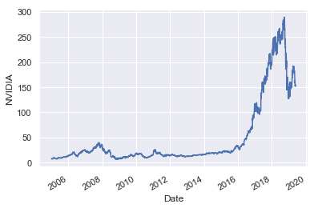
Time Series Data
Time Series: A sequence of observed values in a time-ordered fashion
Observations are recorded at equally spaced time intervals (monthly, weekly, daily, annually etc..)
Time Series Analysis: Study of underlying structure and forces that produce such observations.
Can be thought of containing both descriptive and predictive components.
Predictive components are typically categorized as Time Series Forecasting
Notes:
yearly (ex: annual budget), quarterly (ex: expenses), monthly (ex: air traffic), weekly (ex: sales qty), daily (ex: weather), hourly (ex: stocks price), minutes (ex: inbound calls in a call canter) and even seconds wise (ex: web traffic).
forecasting a time series (like demand and sales) is often of tremendous commercial value.
In most manufacturing companies, it drives the fundamental business planning, procurement and production activities. Any errors in the forecasts will ripple down throughout the supply chain or any business context for that matter. So it’s important to get the forecasts accurate in order to save on costs and is critical to success.

Slide 5
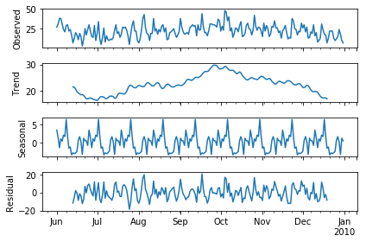
Time Series Components
Observed: Actual data
Trend: Data trend with respect to time
Seasonality: Periodic fluctuations in the observed data (less than a year)
Residual: Remaining signal after removing seasonality and trend
Notes:
Cyclical: Periodic behaviors happening over several years
How to diffentiate between a ‘cyclic’ vs ‘seasonal’ pattern?
If the patterns are not of fixed calendar based frequencies, then it is cyclic. Because, unlike the seasonality, cyclic effects are typically influenced by the business and other socio-economic factors.

Slide 6
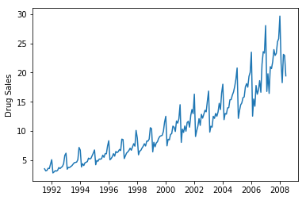
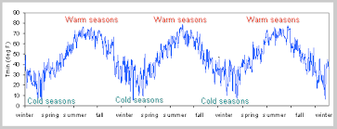
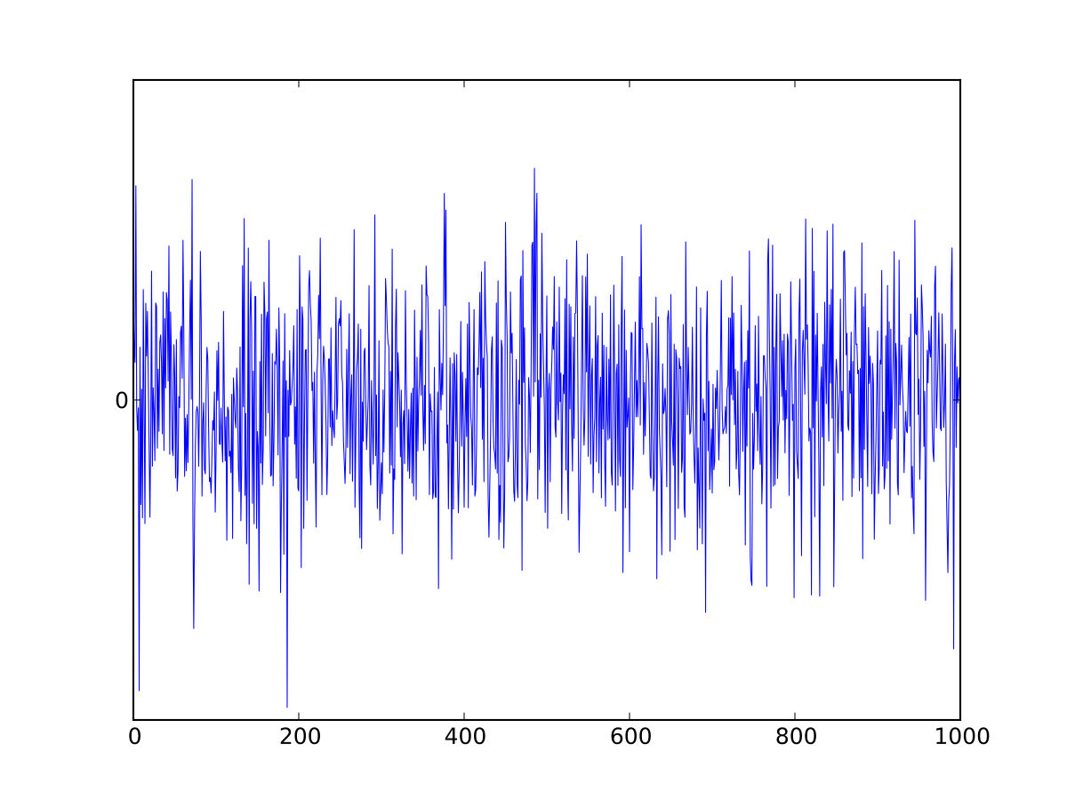
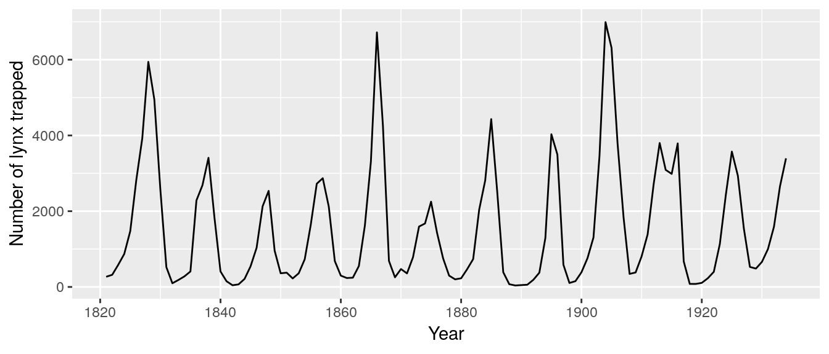
Time Series Patterns

Slide 7
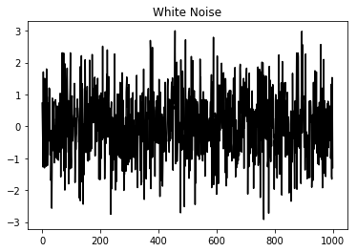
White Noise
Purely random
Mean = 0
No correlation in the series

Slide 8

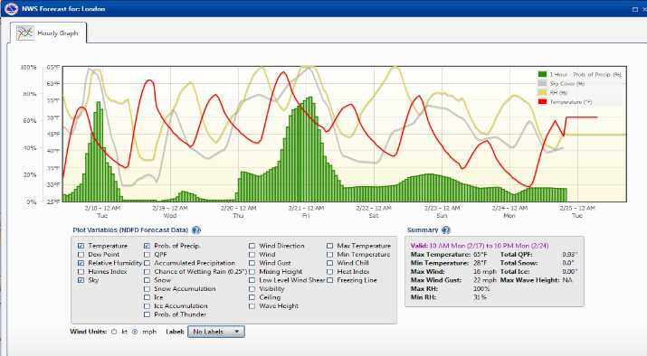
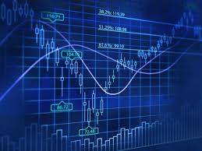
Applications
Econometrics
Mathematical finance
Weather forecasting
Signal Processing
Any domain with temporal measurements

Slide 9
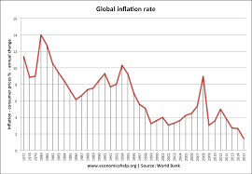
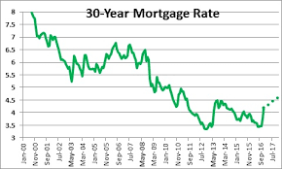
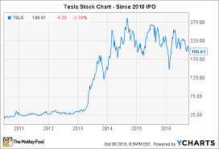
Applications
Forecasting inflation
Forecasting product demand
Forecasting unemployment rates
Forecasting Mortgage or interest rates
Forecasting number of clicks and users on a website
Forecasting stock, gold, crypto prices

Slide 10
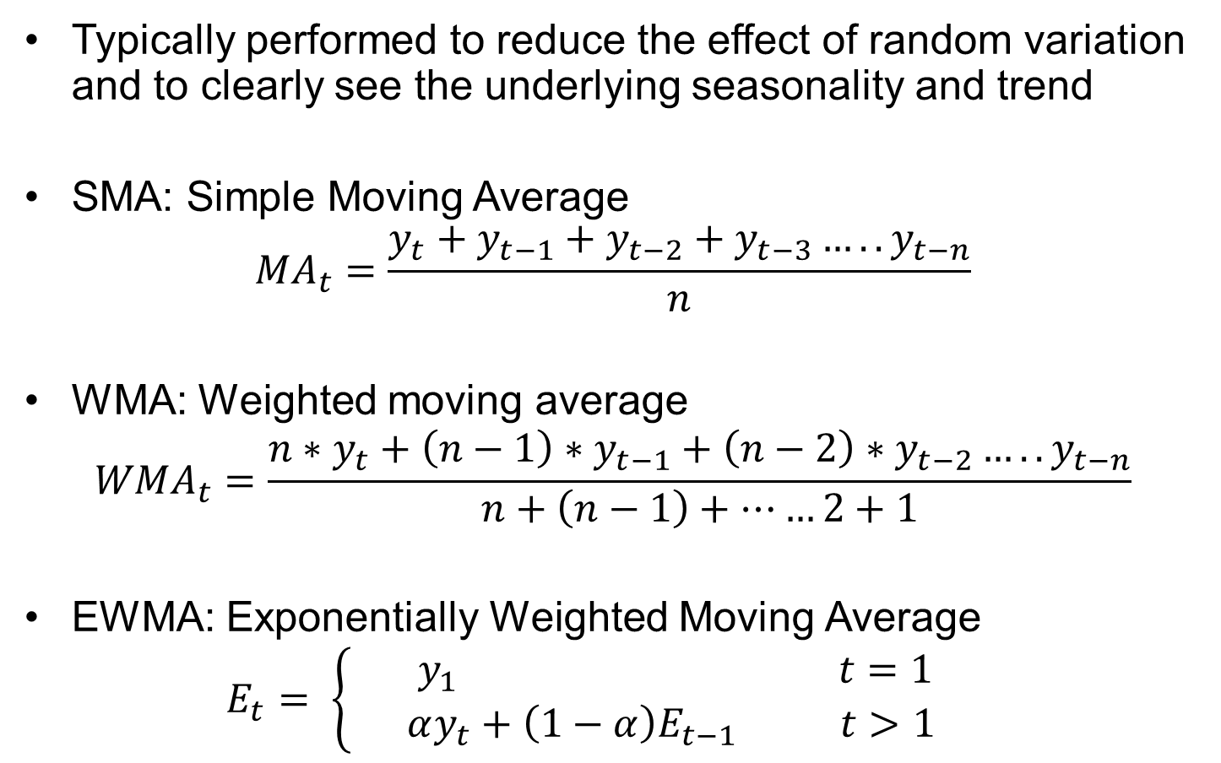
Smoothing
Typically performed to reduce the effect of random variation and to clearly see the underlying seasonality and trend
SMA: Simple Moving Average
$${MA}_{t}=\frac{y_{t}+y_{t−1}+y_{t−2}+y_{t−3}…..y_{t−n}}{n}$$
WMA: Weighted moving average
$${WMA}_{t}=\frac{n∗y_{t}+{\left(n−1\right)∗y}_{t−1}+{\left(n−2\right)∗y}_{t−2}…..y_{t−n}}{n+\left(n−1\right)+……2+1}$$
EWMA: Exponentially Weighted Moving Average
$$E_{t}= \left\{ \begin{aligned}y_{1} t=1 \\ αy_{t}+\left(1−α\right)E_{t−1} t>1 \end{aligned}\right.$$

Slide 11
Time Series Forecasting
It uses past data to predict current and future data.
It is a form of supervised learning since it trains a regression model of data values versus time.
Suitable for single-dimension time series data (Ex: CPU Utilization over time).
Predictions made by a forecasting model will correspond to the expected value that the time series will have in the next time step.
CPU Utilization over time

Slide 12
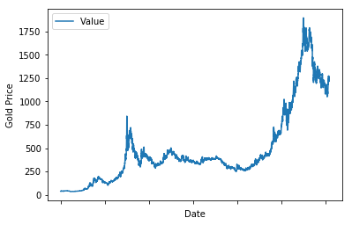
Methods for forecasting
Simple regression models
Auto Regressive Modeling
Moving Average Modeling
Auto regressive Moving Average modeling (ARMA)
Auto regressive Integrated Moving Average modeling (ARIMA)
Variations of ARIMA

Slide 13
Simple Regression on Time series

Slide 14
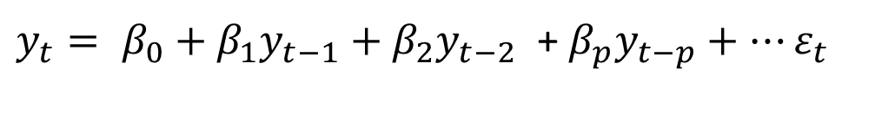
Autoregressive Modeling
Linear regression model where current values are regressed upon prior observations.
y_{t}: Observation at time t
p: order of the AR model (number of lags)
β₀, β₁, β₂,… β_{p} : Coefficients
$y_{t}= β_{0}+β_{1}y_{t−1}+β_{2}y_{t−2}$ + $β_{p}y_{t−p}+…ε_{t}$
Date 1991-07-01 | Sales 3.526591
1991-08-01 | 3.180891
1991-09-01 | 3.252221
1991-10-01 | 3.611003
1991-11-01 | 3.565869
Notes:
Works well when the correlation between a past value and the present value is good. Autocorrelation is good

Slide 15
Auto Correlation Plots

Slide 16
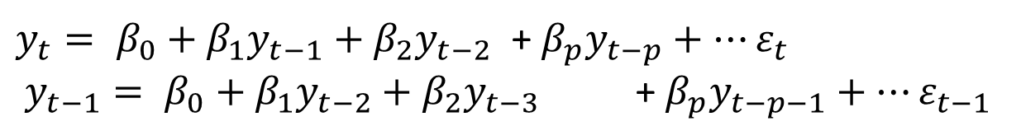
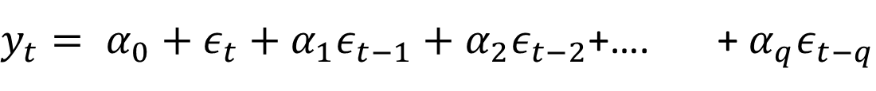
Moving Average Modeling
Current values are regressed upon error terms from the AR model
From the AR model
$y_{t}= α_{0}+{ε_{t}+α}_{1}ε_{t−1}+α_{2}ε_{t−2}$+…. + $α_{q}ε_{t−q}$
y_{t}: Observation at time t
ɛ_{t}: Error term at time t
q: order of the MA model
α₀, α ₁, α ₂,… α _{p} : Coefficients
$y_{t}= β_{0}+β_{1}y_{t−1}+β_{2}y_{t−2}$ + $β_{p}y_{t−p}+…ε_{t}$
$y_{t−1}= β_{0}+β_{1}y_{t−2}+β_{2}y_{t−3}$ + $β_{p}y_{t−p−1}+…ε_{t−1}$

Slide 17
ARMA
ARMA (Autoregressive moving average) is a powerful technique to perform forecasting on time-series
Belongs to the class of statistical models that have outputs linearly dependent on their own prior values
Exponential smoothing can be treated as a special case of ARIMA
Past or previous time data is regressed to predict current (or future time) data pattern
Combination of both AR and MA models

Slide 18
ARIMA for Forecasting
Observed data
Observed data
CPU Utilization Rate
No Anomaly
Anomaly
Time
Time
When observed values
differ from prediction,
Anomaly is raised
ARIMA prediction
ARIMA prediction
CPU Utilization Rate
Time
Time

Slide 19
ARIMA (p,d,q)
ARIMA (Autoregressive integrated moving average)
$y_{t}= β_{0}+β_{1}y_{t−1}+β_{2}y_{t−2}$+ …$β_{p}y_{t−p}+{ε_{t}+α}_{1}ε_{t−1}+α_{2}ε_{t−2}\text{ + }{….α}_{q}ε_{t−q}$
y_{t}: Observation at time t
p: Order of the AR model
d: order of differencing
q: Order of the MA model

Slide 20
ARIMA Assumptions
Stationarity Assumption: Mean, variance, and autocorrelation of a time series are invariant
Differencing: One of the methods to stationarize a series (first order, second order, or seasonal differencing)
Unit Root tests: Statistical tests that help us understand if a timeseries is stationary or not
Notes:
In the most intuitive sense, stationarity means that the statistical properties of a process generating a time series do not change over time. It does not mean that the series does not change over time, just that the way it changes does not itself change over time.

Slide 21
Why stationarity assumption?
Simpler to model a stationary series
Autoregressive models in time series are basically regression models with series lags for independent variables
If a series is stationary, it means there is no autocorrelation, essential saying each lag components are independent and not correlated with each other
If the previous time lag values of a series are independent, then we can use the regression principles with confidence

Slide 22
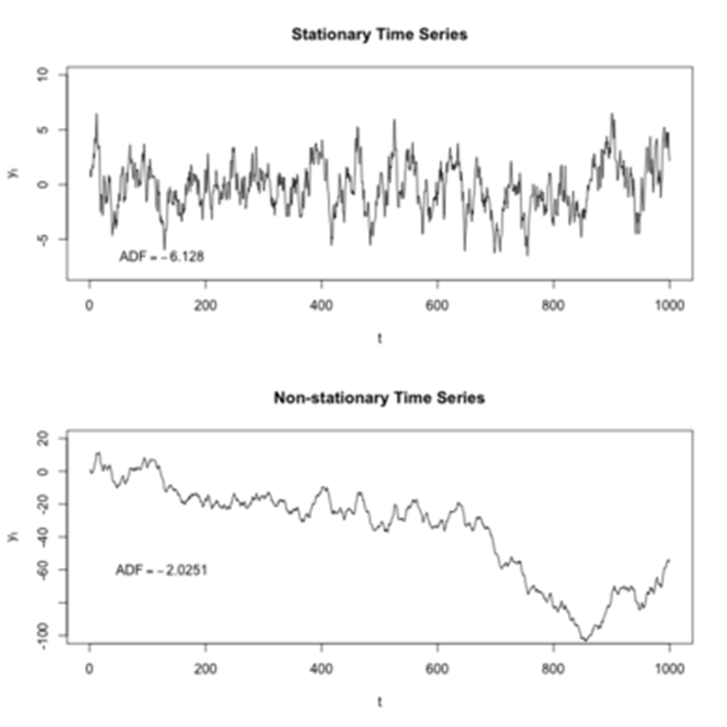
Stationary and non-stationary series

Slide 23
How to test for stationarity
Looking at Plots
Summary statistics
Statistical Tests
Augmented Dickey Fuller test (ADH Test)

Slide 24
How to make series stationary?
Differencing the series
Log of series
Nth root of series
Combination of above methods

Slide 25
Thank You ☺
Any questions?

